Slide 1







Proposal-Free Temporal Action Detection
via Global Segmentation Mask Learning
Sauradip Nag^{1,2} Xiatian Zhu^{2,3} Yi-Zhe Song^{1,2} Tao Xiang^{1,2}
¹CVSSP, University of Surrey, UK
²iFlyTek-Surrey Joint Research Centre for Artificial Intelligence
³Surrey Institute for People-Centred Artificial Intelligence, University of Surrey, UK

Slide 2

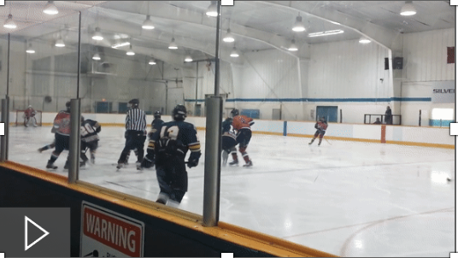
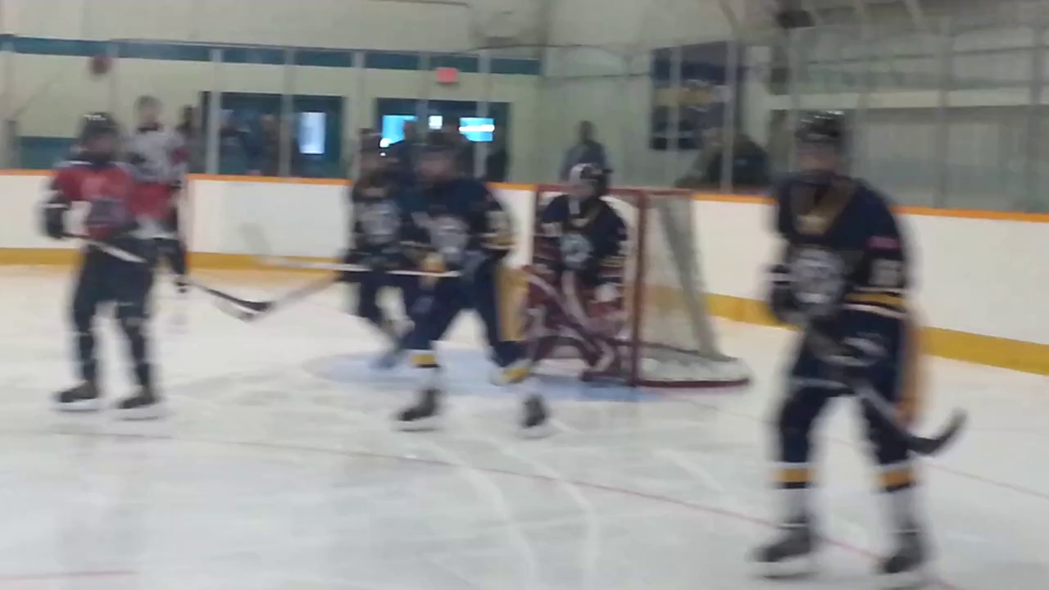
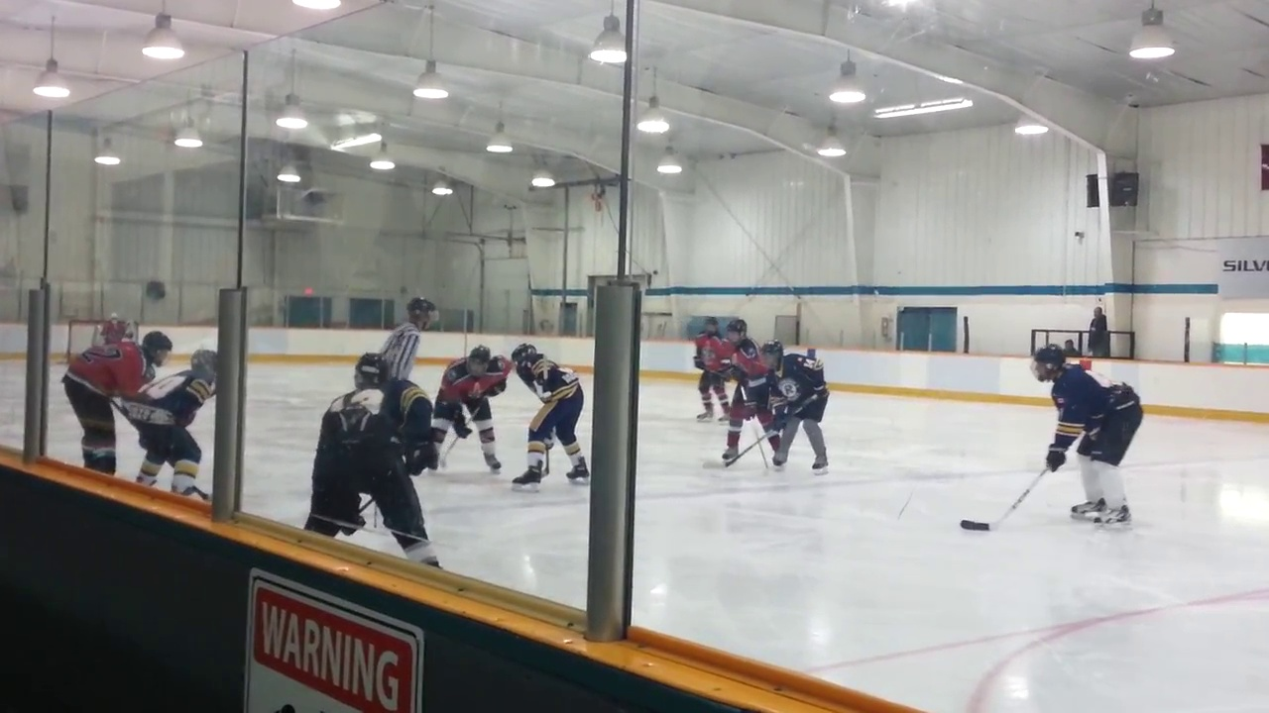
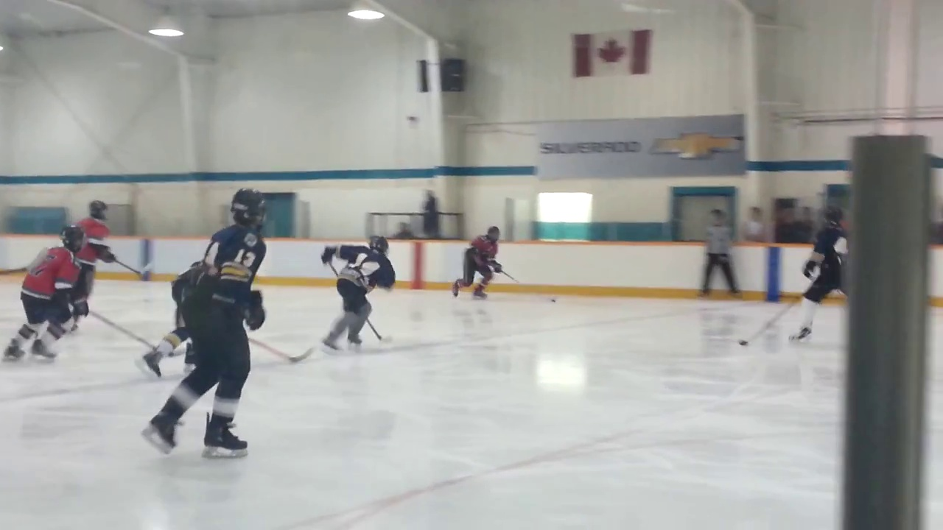
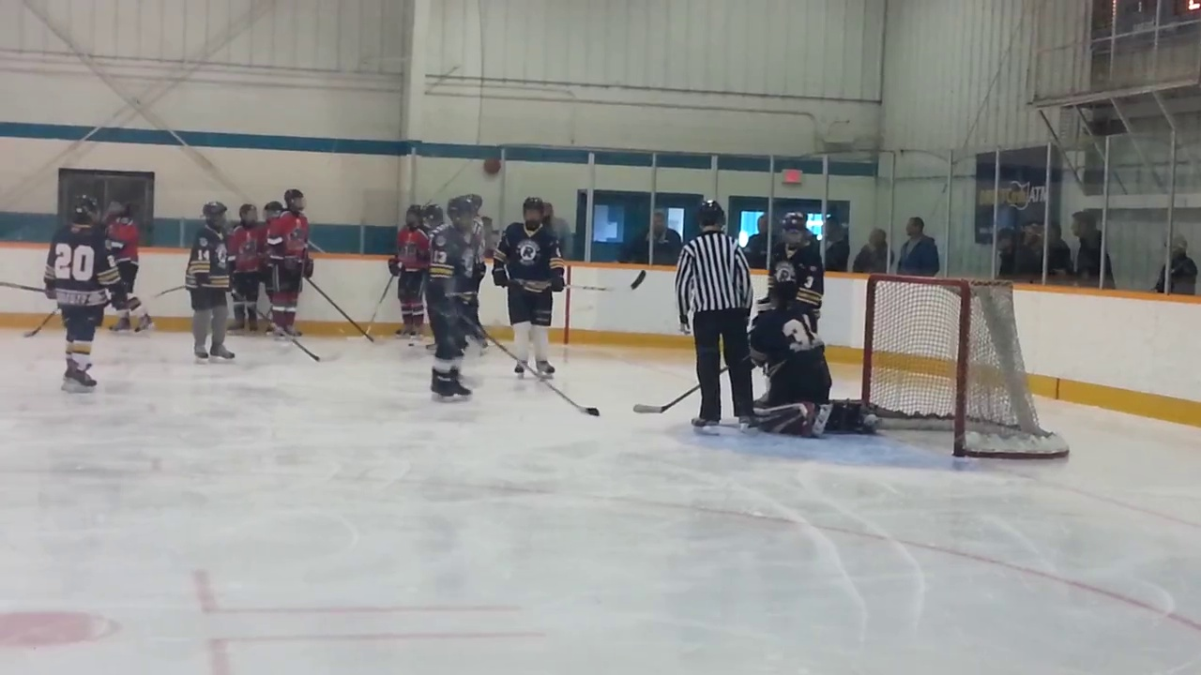
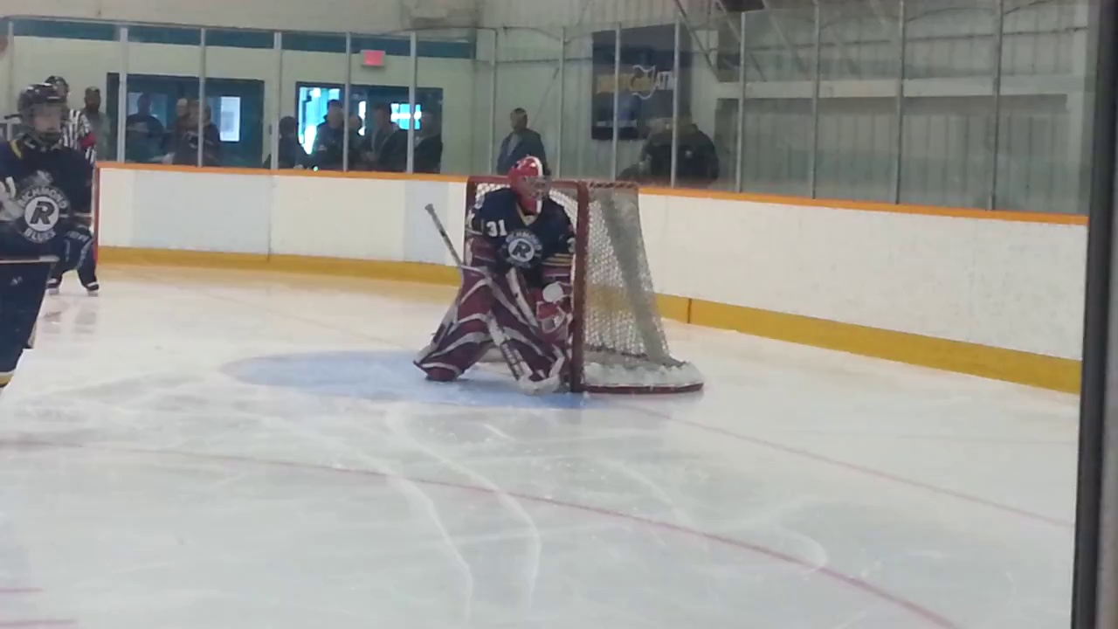
What is Temporal Action Detection ?
What is the Activity ?
(“Playing Ice Hockey”)
SubTask 1 : Action Classification
When is the Activity Occuring ?
(13 s – 28 s )
SubTask 2 : Temporal Regression
Untrimmed Video
Task Definition
Playing Ice Hockey
0
13
28
36 (in sec)

Slide 3
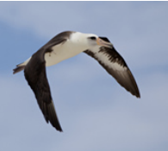
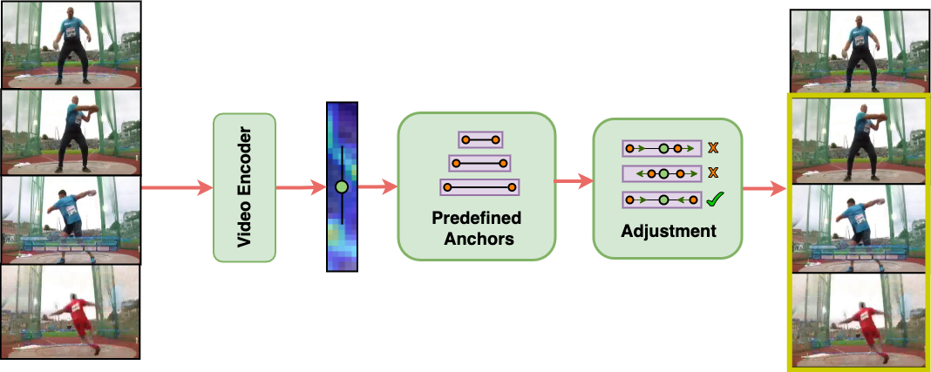
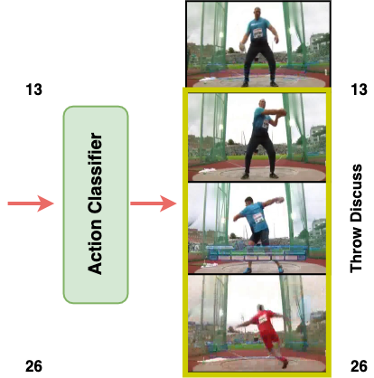
Prior Work
Anchor Based Obj Det
1) Anchor Based Proposal Learning
Ex : R-C3D¹ ( ICCV17 )
Two Stage Network Design – 1) First Detect Action Boundary 2) Classify Action within boundary
Too many proposals (~ 8k) generated for detecting the temporal boundaries
Requires extra hyperparams for tuning the anchors similar to anchor based object detection
¹Xu, Huijuan, Abir Das, and Kate Saenko. "R-c3d: Region convolutional 3d network for temporal activity detection." ICCV. 2017.

Slide 4
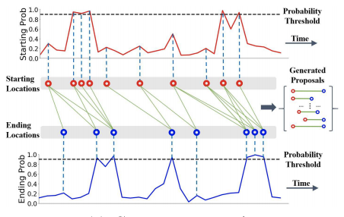
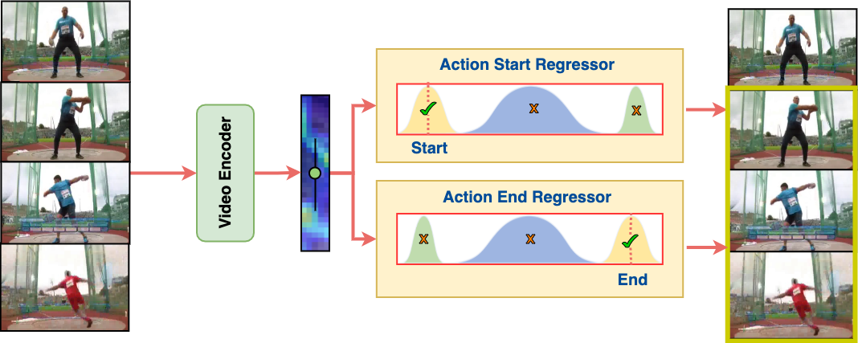
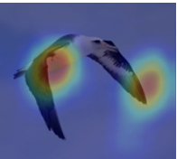
Prior Work
Anchor Free Obj Det
2) Anchor Free Proposal Learning
Ex : BMN² ( ICCV19 )
Two Stage Network Design – 1) First Detect Action Boundary 2) Classify Action within boundary
Each temporal location is processed individually using IOU regression, thus captures only local context
Does not use anchors but exhaustively tries to find the action boundaries comparing each location motivated
by Anchor-free object detection
²Lin, Tianwei, et al. "Bmn: Boundary-matching network for temporal action proposal generation.” ICCV 2019.

Slide 5
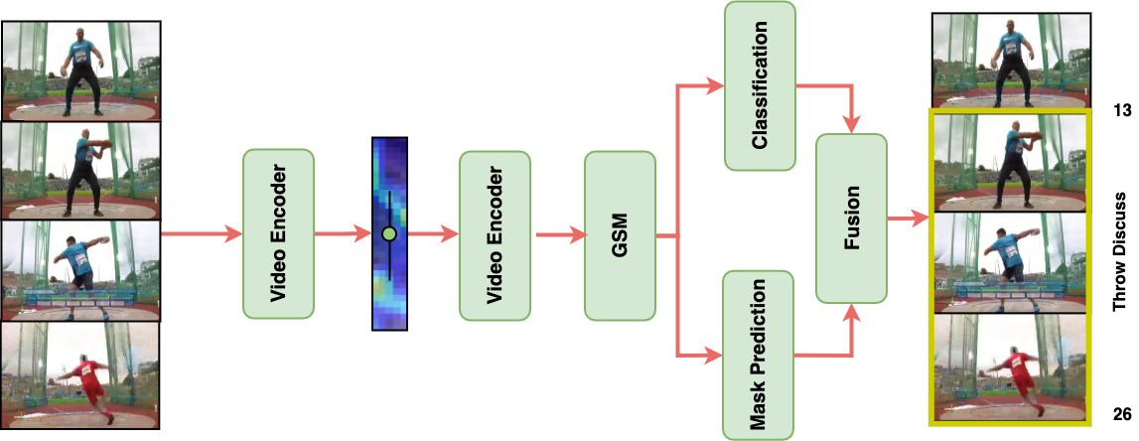
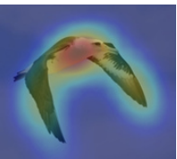
Proposal Free Learning
Object Localization based Detection
Mask Start
Mapping
Global Mask Generator
Foreground
Mask End
Temporal Location is processed globally using Transformers.
Uses binary action masks to model action boundary instead of proposals , draws analogy from object localization
Mask boundaries are action boundaries i.e No Proposal Learning

Slide 6
Proposal Free Learning
Object Localization based Detection
Mask Start
Mapping
Global Mask Generator
Foreground
Mask End
Temporal Location is processed globally using Transformers.
Uses binary action masks to model action boundary instead of proposals , draws analogy from object localization
Mask boundaries are action boundaries i.e No Proposal Learning

Slide 7
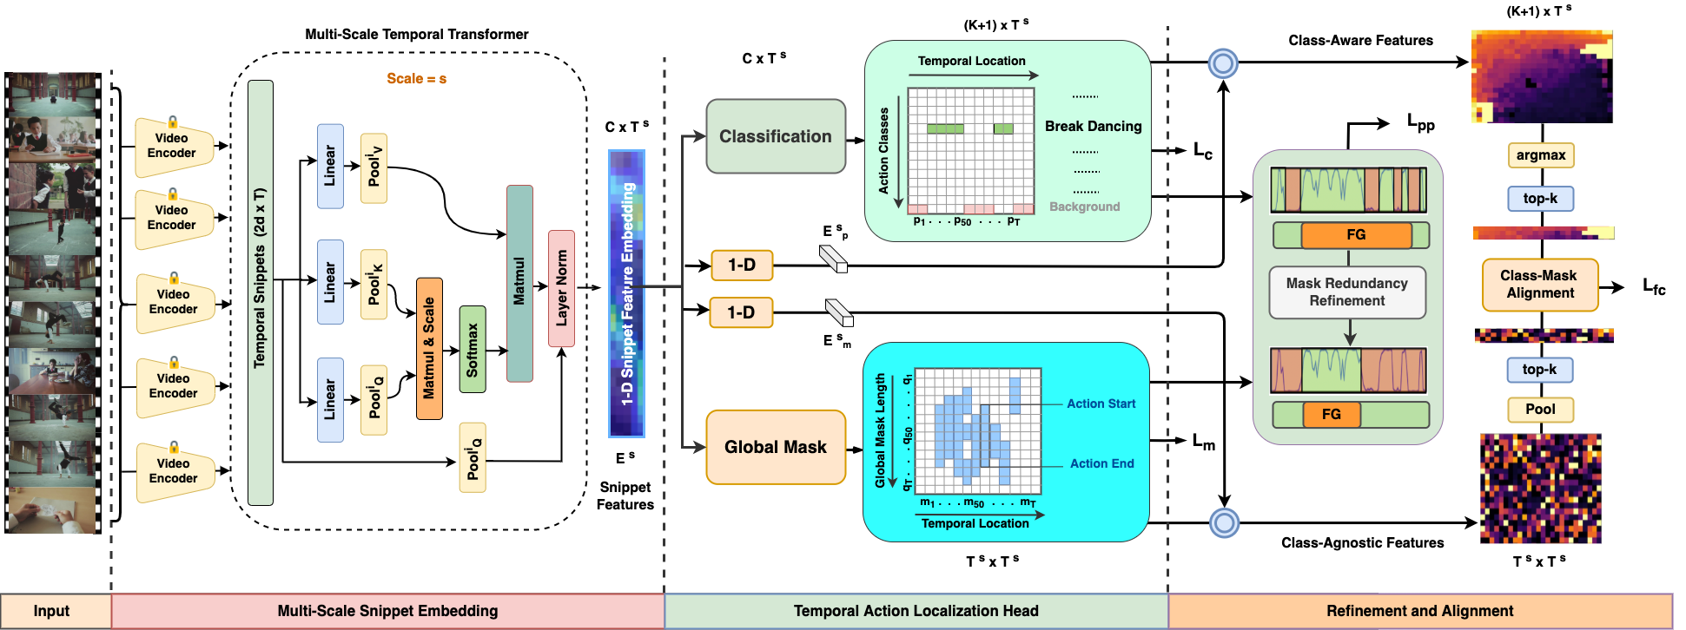
Our Approach – Temporal Action Detection using Global Segmentation ( TAGS )
We introduce TAGS - A new proposal-free approach to Localize Actions
a) Single Stage and Efficient b) Action Masks instead of Proposals c) Embarrassingly Simple Design

Slide 8
TAGS : Multi-Scale Snippet Embedding Module
Goal : Given a video , generate
a multi-scale global embedding
Raw Video Frames are passed into a Frozen Video Encoder* to obtain Snippets
Each Snippet is passed into a Multi-Head Transformer ( Embedding Module ) to obtain the Global Context .
* Encoders ( I3D/C3D – ConvLSTM based ) are finetuned on Kinetics Dataset for Action Classification

Slide 9
TAGS : Temporal Action Detection Head
Goal : Given a video embedding
detect action at coarse-level
Each Temporal Location (Snippet) is classified into one of (K+1) classes including background
Each positive action location is mapped to a global mask in Mask Branch
Even with one positive action snippet, we get a) Action Class b) Action Boundary

Slide 10
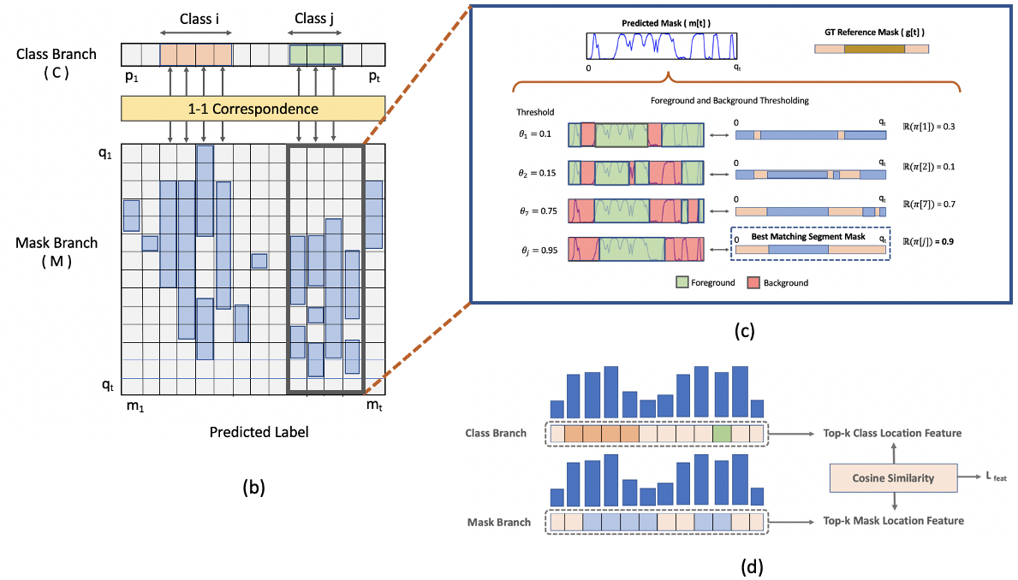
TAGS : Mask Redundancy and Inter-Branch Consistency
Goal : Given coarse predictions,
refine the predictions at feature level
Mask Redundancy : All the masks belonging to a action instance should be of equal length
Inter-Branch Consistency : All the foreground features in Class and Mask branch should be similar.

Slide 11
TAGS : Label Assignment and Inference
GT Label : All the snippets (orange or blue squares) of a single action instance with the same action class.
Inference : Select the top-k Class and corresponding masks and threshold masks to obtain start/end of action.

Slide 12
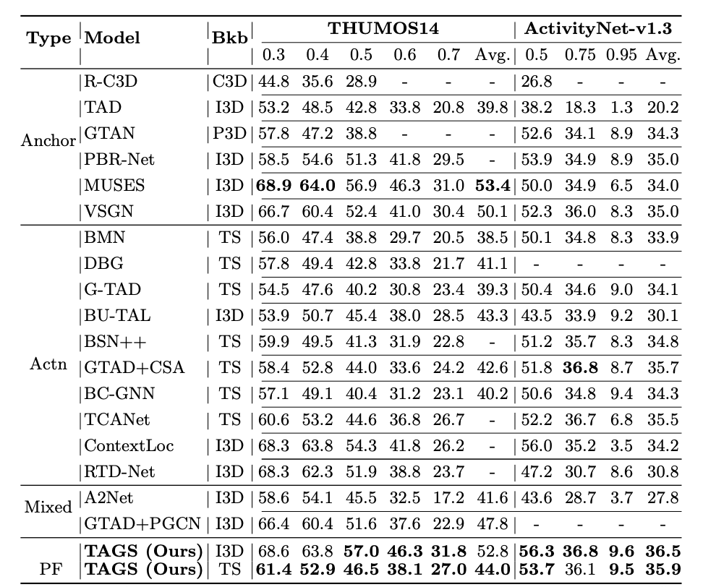


Quantitative Results
Datasets :
9k Training, 5k Testing Video
1.
Short Videos ( ~ 3-4 mins )
70% Long Single FG Instance
200 Training, 213 Testing Video
2.
Long Videos ( ~ 9-14 mins )
85% Short Multi FG Instance
Performance :
We reach new SOTA on both the Datasets
Improving by a margin of ~ 1.5 % on Avg mAP
and ~ 3.4 % on mAP@0.5
Table 1

Slide 13
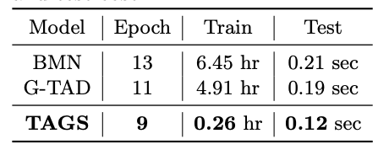
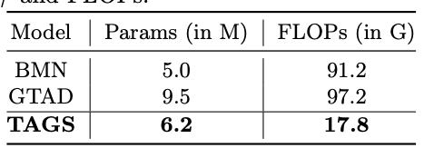
Ablation Studies : Speed and Efficiency
Table 2
Table 3
Train and Test Speed
Parameter Efficiency

Slide 14
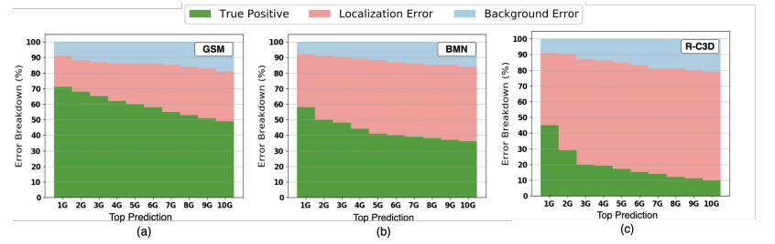
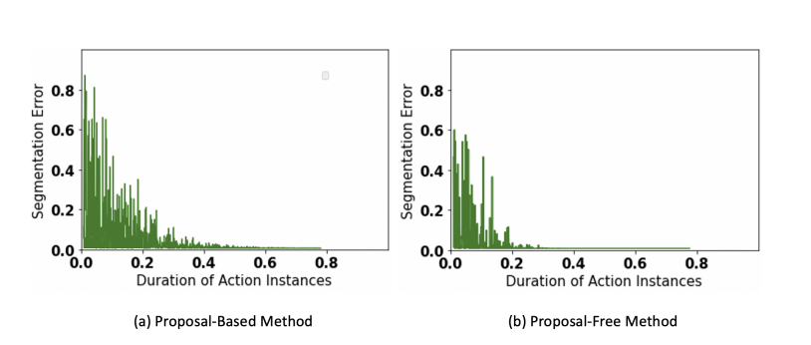
Ablation Studies : Proposal-Free vs Proposal-Based
False Positive Analysis
Proposal Error vs Duration

Slide 15
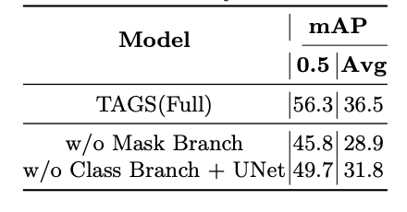
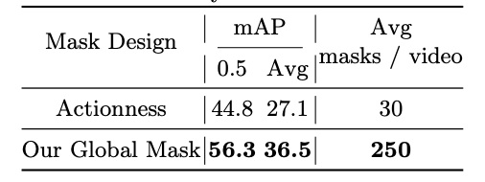
Ablation Studies : Design Advantages
Table 4
Table 5
Branch Design Analysis
Actionness vs Global-Mask

Slide 16
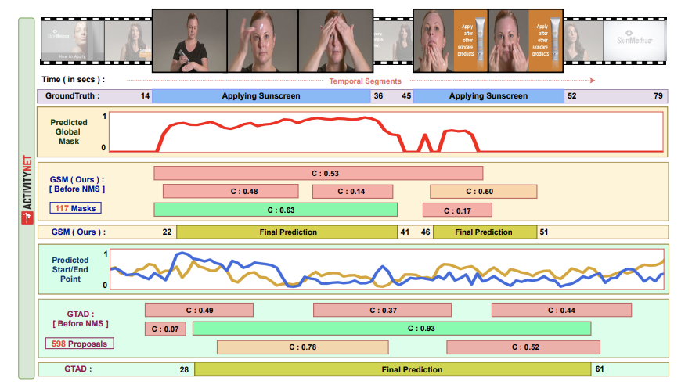
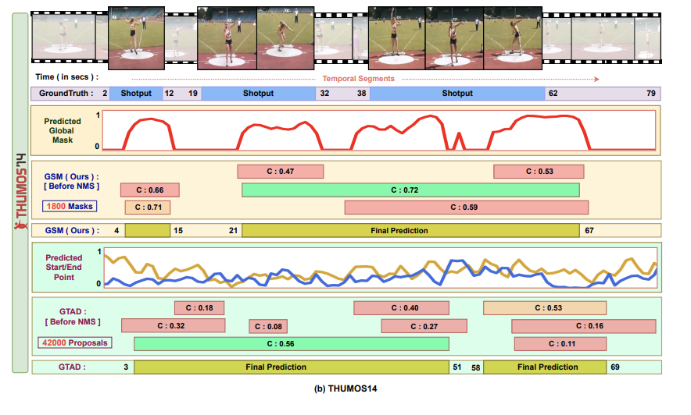
Qualitative Results
ActivityNet v1.3
THUMOS14

Slide 17

Thank You for Listening
Scan the QR Code for more details

